Slide 1

B.Tech | BCSE497J – Project - I
Federated Learning for Privacy-Preserving Medical Diagnosis
Review – 1
Team members:
Shaurya Saini (23BCT0074)
Pooja Goel (23BCT0106)
Devraj Chandani (23BCT0217)
Faculty guide:
Prof. Jabanjalin Hilda J
Notes:
Good morning. We're presenting Review-1 of our Project-I under BCSE497J — "Federated Learning for Privacy-Preserving Medical Diagnosis." I'm Shaurya, and with me are Pooja and Devraj.
The one-line framing: hospitals cannot pool patient data because of HIPAA, GDPR and India's DPDP Act, yet no single hospital holds enough data to train a reliable diagnostic model. Federated learning is the standard answer — but federated learning on its own is neither actually private nor safe against a malicious participant. This project builds and measures a framework that closes both holes at once.
I'll cover our aim, abstract, literature survey, the research gap, and our eight objectives.

Slide 2


Slide 3
Aim
To design, implement and empirically evaluate a privacy-preserving federated learning (FL) framework for collaborative medical diagnosis, in which geographically separated healthcare institutions jointly train a shared deep learning model by exchanging only protected model updates — never raw patient records.
The framework integrates differential privacy (DP) for formal, quantifiable leakage guarantees and Byzantine fault-tolerant aggregation for integrity against faulty or malicious participating nodes. Chest radiography (multi-label disease detection with per-disease severity grading) is used as the validation task that demonstrates the architecture is clinically viable — it is not itself the research problem.
The central aim is to characterise and optimise the privacy–robustness–utility trade-off that determines whether federated medical AI can be deployed in practice.
Notes:
Our aim, stated formally: to design, implement and empirically evaluate a privacy-preserving federated learning framework for collaborative medical diagnosis.
Three things to emphasise here.
First, the defining property — institutions exchange only protected model updates. Raw patient records never leave the hospital.
Second, we embed two defence layers, not one. Differential privacy gives a formal, quantifiable leakage guarantee. Byzantine fault-tolerant aggregation gives integrity when a participating node is faulty or actively malicious. Most work in this area does one or the other, never both.
Third, and this is the point I'd most like the panel to note: chest radiography is our validation task, not our research problem. The research problem is the privacy-robustness-utility trade-off. The X-rays are how we demonstrate the architecture is clinically viable.

Slide 4
Abstract
Clinical deep learning is bottlenecked not by model capacity but by data access. Individual hospitals hold datasets that are small, demographically narrow and acquisition-biased, while regulatory frameworks (HIPAA, GDPR, India's DPDP Act) make raw-data centralization infeasible. Federated learning addresses this by keeping data in place and aggregating only model updates — but FL alone is not a privacy guarantee. Shared gradients are invertible via reconstruction and membership-inference attacks, and the open participation model exposes the global model to poisoning and Byzantine faults from compromised or misconfigured clients.
This work proposes a hierarchical client–server federated architecture for medical diagnosis, in which each leaf node (hospital) performs local training and a center node performs secured aggregation. Two defense layers are embedded directly into the training loop: (i) client-level differential privacy via per-sample gradient clipping and calibrated Gaussian noise under a Rényi-DP accountant, yielding a stated privacy budget (ε, δ); and (ii) Byzantine-robust aggregation — Krum/Multi-Krum, coordinate-wise trimmed mean/median, and similarity-based trust weighting — replacing plain FedAvg, so that a bounded fraction of adversarial updates cannot dominate the global model. Statistical heterogeneity across sites (non-IID label and feature skew) is handled through proximal regularization and local batch normalization.
The framework is instantiated on multi-institutional chest radiograph data partitioned across simulated hospital nodes, performing multi-label pathology detection and ordinal severity grading. Evaluation compares the federated global model against isolated single-site baselines and a centralized upper bound, measured across varying privacy budgets, adversarial client fractions and heterogeneity levels. Crucially, the system is audited empirically - gradient-inversion and membership-inference attacks are executed against the shared updates to verify that the claimed privacy is actually realized, rather than assumed by construction. The expected outcome is a reproducible, threat-model-explicit blueprint for federated clinical AI, together with an empirical map of the regimes in which privacy, robustness and diagnostic accuracy can be jointly satisfied.
Notes:
The abstract, in three parts.
The first paragraph is the problem. Clinical deep learning is bottlenecked by data access, not model capacity. Any single hospital's dataset is small, demographically narrow and biased by its own scanners. Regulation rules out centralising raw records. Federated learning is the standard response — but here is the claim this whole project rests on: FL alone is not a privacy guarantee. It fails two ways. Shared gradients are invertible, so reconstruction and membership-inference attacks recover training data. And because participation is open, a compromised or misconfigured client can poison the global model.
The second paragraph is what we propose. A hierarchical client-server architecture, with two defence layers embedded inside the training loop rather than bolted on. Client-level differential privacy — per-sample clipping, calibrated Gaussian noise, a Renyi-DP accountant giving us a stated epsilon-delta budget. And Byzantine-robust aggregation — Krum, Multi-Krum, trimmed mean and median, trust weighting — replacing plain FedAvg. Heterogeneity is handled with proximal regularisation and local batch normalisation.
The third paragraph is evaluation. Chest radiographs partitioned across simulated hospital nodes, two tasks, compared against isolated single-site baselines and a centralised upper bound, swept over privacy budget, attacker fraction and heterogeneity. And the word I'd underline is "audited" — we run the attacks against our own system to verify the privacy is real, not assumed.

Slide 5
Literature Review (1/2)
Paper / Year | Objective & Methodology | Findings | Pros / Cons
[1] BASE PAPER FL for Thoracic Disease Classification Using CNNs and Differential Privacy Healthcare Technology Letters, 2026 | Federated framework with differential privacy for multi-label thoracic disease classification from chest radiographs, evaluated on NIH ChestX-ray14 and Stanford CheXpert. Targets resource-constrained clinical environments where data sharing is legally restricted. | Directly quantifies the privacy–utility penalty of DP integration — both accuracy degradation and computational overhead. Establishes CNN-based DP-FL as a workable, reproducible baseline for chest X-ray diagnosis under decentralised training. | Limitation relevant to this work: all clients assumed honest. No adversarial/Byzantine threat model, no robust aggregation, no empirical privacy audit — the privacy claim rests entirely on the analytic ε.
[2] OptiGradTrust: Byzantine-Robust Federated Learning with Multi-Feature Gradient Analysis and Reinforcement Learning-Based Trust Weighting Year: 2025 | Scores every client update using a six-dimensional gradient “fingerprint” (VAE reconstruction error, cosine similarity, L2 norm, sign-consistency ratio, Monte-Carlo Shapley value), fed into a hybrid RL/attention module producing adaptive trust weights. Introduces FedBN-Prox. | Evaluated on MNIST, CIFAR-10 and an Alzheimer's MRI dataset against five Byzantine attack types, IID and non-IID, outperforming FLTrust and FLAME. Treats heterogeneity and adversarial behaviour as coupled problems. | Gap: addresses integrity but not confidentiality — updates are aggregated in the clear, with no differential privacy guarantee.
[3] Privacy-Preserving CXR Report Generation (ViT + GPT-2) 2025 | Federated multimodal pipeline (Vision Transformer encoder + GPT-2 decoder) generating radiology reports without centralising images; compares FedAvg, Krum, and a loss-aware federated averaging variant. | A Byzantine-resilient aggregator (Krum) can outperform plain FedAvg on clinical output quality (ROUGE, BLEU, BERTScore, RaTEScore) even in a benign federation. Federated training matches or surpasses centralised. | Establishes robust aggregation as a first-class design choice in medical FL rather than a pure security add-on. No DP layer is applied.
[4] PFL fused with DP for Arrhythmia Diagnosis 2025, PLOS ONE | Privacy-preserving architecture fusing personalised federated models with local differential privacy for 12-lead ECG arrhythmia diagnosis, using GRU-based temporal modelling and feature fusion across decentralised institutions. | Reports ~93.7% average accuracy over a 10,646-recording ECG corpus while enforcing local DP, outperforming both centralised and federated baselines. | Evidence the FL + DP + personalisation stack is modality-agnostic, generalising beyond imaging to signal-based diagnostics — supporting an architecture-level contribution.
[5] Efficient DP-Enabled FL for COVID-19 Detection 2024, Frontiers in Medicine | Adaptive DP-FL model in which the privacy level is adjusted dynamically according to real-time data-sensitivity analysis, coupled with an early-stopping mechanism that limits privacy-budget consumption during training. | Moves beyond a single fixed ε: adaptive noise calibration improves practical DP-FL utility across diverse hospital environments. Analyses the joint effect of early stopping on both utility and privacy. | Motivates adaptive rather than static budget allocation in the proposed system.
Notes:
Our survey covers ten papers. Reference one is our base paper; I'll start there.
It's a 2026 Healthcare Technology Letters paper proposing a federated framework with differential privacy for multi-label thoracic disease classification, on ChestX-ray14 and CheXpert. We chose it because it directly quantifies what DP costs — accuracy and compute — in a realistic radiology setting, and gives us a reproducible baseline.
The Pros/Cons column is the important one. Every client is assumed honest. No adversarial threat model, no robust aggregation, and no empirical privacy audit — the privacy claim rests entirely on the analytic epsilon. Those two unanswered questions are exactly what we extend.
Taking the rest quickly. OptiGradTrust is our reference for Byzantine robustness — six gradient features, learned trust weights, beats FLTrust and FLAME. But it aggregates in the clear, with no DP.
The ViT-GPT-2 reporting paper gave us a genuinely surprising result: Krum outperformed plain FedAvg on clinical output quality even with no attacker present. That reframes robust aggregation as a design choice, not a security tax.
The arrhythmia paper matters for scope — roughly ninety-four percent accuracy on ECG under local DP tells us this stack is modality-agnostic, which supports our framing that the contribution is architectural.
And the adaptive DP-FL paper pushed us away from a single fixed epsilon toward adaptive budget allocation.

Slide 6
Literature Review (2/2)
Paper / Year | Objective & Methodology | Findings | Pros / Cons
[6] FL Enables Big Data for Rare Cancer Boundary Detection 2022, Nature Communications | Largest federated study in medicine at publication: 71 sites across 6 continents collaboratively training a glioblastoma tumour-boundary detector (n = 6,314) by sharing only numerical model updates. | 33% delineation improvement for the surgically targetable tumour and 23% for full tumour extent over a publicly trained model. Strongest evidence that federated aggregation improves out-of-sample generalisability for rare diseases. | Gap: no formal DP guarantee and no adversarial threat model; mutual trust between the 71 sites is assumed by construction.
[7] Defending Against Reconstruction Attacks Through DP-FL 2022, Sensors | Evaluates DP-FL specifically as a defence against privacy attacks, comparing DenseNet121 and ResNet50 across an imbalanced, heterogeneous federation of 36 clients built from CheXpert and Mendeley chest X-ray data. | Non-private baselines reach AUC ≈ 0.94, but both architectures leak: image-reconstruction attacks successfully recover training data from individual client updates. DenseNet121 is the more DP-friendly backbone. | The clearest published evidence that FL without DP is not privacy-preserving — the direct motivation for this project's empirical privacy-audit component.
[8] FL and Differential Privacy for Medical Image Analysis 2022, Scientific Reports | Systematic case study of DP-FL on histopathology whole-slide images from The Cancer Genome Atlas, varying the number of participating providers, per-site dataset size, and IID vs non-IID distribution. | Isolates federation topology as an independent experimental variable: client count and data skew — not only the privacy budget — determine achievable accuracy. Non-IID skew compounds the DP utility penalty. | Provides the experimental-design template for the heterogeneity and client-count sweeps proposed here.
[9] PriMIA — End-to-End Privacy Preserving DL on Multi-Institutional Imaging 2021, Nature Machine Intelligence | Open-source framework combining differentially private federated training, secure aggregation, and encrypted remote inference, validated on expert-level paediatric chest X-ray classification. | Performance on par with locally, non-securely trained models while providing both theoretical and empirical privacy guarantees. Protections prevent recovery of usable data by a gradient-based model-inversion attack. | Closest precedent for an end-to-end secured medical FL stack; models a curious server/adversary only, not malicious participants, so Byzantine integrity is out of scope.
[10] EXAM — FL for Predicting Clinical Outcomes in COVID-19 2021, Nature Medicine | Federated model trained across 20 institutes worldwide on vital signs, laboratory values and chest X-rays, predicting future oxygen requirements of symptomatic COVID-19 patients. | Average AUC > 0.92 at 24 h and 72 h from emergency-room presentation. 16% average AUC improvement and 38% average increase in generalisability over models trained at a single site — the canonical justification for our core hypothesis. | Gap: standard federated averaging, no declared privacy budget, no robustness mechanism.
Notes:
The remaining five papers.
The Nature Communications rare-cancer study is the headline evidence for why federation is worth the trouble: seventy-one sites, six continents, a thirty-three percent improvement in delineating the surgically targetable tumour. But no DP guarantee, and mutual trust between all seventy-one sites simply assumed.
The Sensors paper is, for us, the single most important supporting reference. The authors do not argue that federated learning might leak — they demonstrate it. Non-private baselines reach AUC around 0.94, and image-reconstruction attacks successfully recover training data from individual client updates, for both backbones. That is the direct motivation for why we audit rather than assert.
The Scientific Reports study is our experimental-design template — it isolates federation topology as an independent variable and shows non-IID skew compounds the DP penalty rather than acting independently of it.
PriMIA is the closest existing precedent to what we want to build, and one of very few works that verifies its privacy claim by running a model-inversion attack. But it models only a curious server; malicious participants are explicitly out of scope.
And EXAM gives us our quantitative justification: sixteen percent average AUC improvement, thirty-eight percent better generalisability, over single-site models. Again — plain FedAvg, no declared budget, no robustness.
Notice the pattern across all ten. That pattern is our research gap.

Slide 7
Research Gap (1/2)
G1 — Privacy and robustness are studied in isolation, never jointly.
DP-FL work ([1], [5], [7], [8], [9]) assumes an honest-but-curious server with fully cooperative clients. Byzantine-robust work ([2], [3]) assumes plaintext, noise-free updates. No study systematically characterises their interaction, despite a direct conflict: DP gradient clipping and Gaussian noise deliberately destroy the very statistical structure (update norm, direction, inter-client similarity) that robust aggregators such as Krum, trimmed-mean and FLTrust rely on to identify malicious contributions. A defence that is sound in isolation may fail under composition.
G2 — Clinically validated deployments carry no formal guarantees.
The large-scale studies that prove FL works clinically ([6], [10]) use plain FedAvg with an implicit trust assumption, no stated ε, and no adversarial threat model. Conversely, frameworks with strong formal guarantees ([9]) are demonstrated only at small scale. There is no bridge between clinical credibility and cryptographic/statistical rigour.
G3 — Privacy is asserted rather than audited.
Most medical FL literature treats privacy preservation as an architectural property that follows automatically from not moving data. Only a minority ([7], [9]) execute reconstruction attacks against their own system. The field lacks the standard practice of reporting measured residual leakage at a declared privacy budget.
Notes:
From that survey we identified six gaps — three here, three next.
Gap one is our central gap, so I'll spend the most time on it. Privacy and robustness are always studied separately. The DP-FL papers assume every client is honest and cooperative. The Byzantine-robust papers assume updates arrive in plaintext with no noise. Nobody characterises what happens when you compose them — and there is a direct mechanical conflict. Differential privacy works by clipping gradients and adding Gaussian noise, which deliberately destroys exactly the statistical structure — update norm, direction, inter-client similarity — that Krum and trimmed-mean use to spot a malicious client. In other words, turning on privacy may blind your robustness defence. A defence sound in isolation may fail under composition. Nobody has measured that.
Gap two is a credibility split. The studies proving FL works in a real clinic use plain FedAvg, no stated epsilon, no threat model. The frameworks with real formal guarantees are small-scale only. No bridge between the two.
Gap three: privacy is asserted, not audited. Most of the literature treats "we didn't move the data" as if it were itself the guarantee. Only two of our ten papers actually attack their own system. Reporting measured residual leakage at a declared budget is not yet standard practice.

Slide 8
Research Gap (2/2)
G4 — Heterogeneity interacts with both defences, and is unquantified.
Non-IID skew arising from scanner vendors, acquisition protocols and differing disease prevalence is handled by FedProx/FedBN-style methods ([2], [8]), but their behaviour under simultaneous DP clipping and robust aggregation is unstudied. Honest minority-distribution clients can be statistically indistinguishable from attackers, so a robust aggregator risks silently excluding exactly the underrepresented sites that federation was designed to include — a fairness failure with direct clinical consequences.
G5 — No unified, reproducible testbed.
Results across the literature are not comparable, because each work fixes a different subset of {privacy budget, attacker fraction, heterogeneity level, aggregation rule, backbone}. No open framework exists that allows these axes to be swept jointly on a common medical benchmark.
Notes:
The remaining three gaps.
Gap four has the sharpest ethical edge. Real hospitals differ — different scanner vendors, acquisition protocols, disease prevalence. FedProx and FedBN-style methods handle that skew. But nobody has studied how they behave when DP clipping and robust aggregation run at the same time. And here's the danger: an honest hospital holding a minority data distribution can look statistically identical to an attacker. So a robust aggregator may silently exclude precisely the underrepresented sites federation existed to include. That's a fairness failure with direct clinical consequences, and it is currently unquantified.
Gap five is about clinical usefulness. Federated radiology almost always asks "is the pathology present or absent." What actually drives triage is severity. Ordinal severity grading under federated, privacy-constrained training is essentially unexplored.
Gap six is methodological. Every paper fixes a different combination of privacy budget, attacker fraction, heterogeneity, aggregation rule and backbone — so results cannot be compared. There is no common testbed.
These six gaps map directly onto our objectives.

Slide 9
Objectives
1. Design a hierarchical federated architecture for multi-institutional medical diagnosis — a coordinating centre node with N leaf nodes — exposing a modular interface so that the aggregation rule and the privacy mechanism can be swapped independently.
2. Integrate client-level differential privacy into local training through per-sample gradient clipping and calibrated Gaussian noise, with a Rényi-DP accountant reporting a formal cumulative (ε, δ) budget for the complete training run.
3. Implement and compare Byzantine fault-tolerant aggregation rules — Krum/Multi-Krum, coordinate-wise trimmed mean and median, and similarity-based trust weighting — against FedAvg under label-flipping, sign-flipping, scaled-update and model-replacement attacks at varying adversarial client fractions.
4. Characterise the joint privacy–robustness–utility trade-off as the primary research contribution: measure diagnostic performance as a function of (ε, attacker fraction, heterogeneity level) and identify the regimes in which DP noise measurably degrades the detection capability of robust aggregation.
5. Validate on chest radiography with two prediction heads — multi-label pathology detection and per-disease ordinal severity grading (mild / moderate / severe) — benchmarking the federated global model against (a) isolated single-site models and (b) a centralised upper bound.
6. Empirically audit the privacy claim by executing gradient-inversion and membership-inference attacks against intercepted client updates, reporting measured reconstruction quality (SSIM/PSNR) and attack success rate at each privacy budget, instead of asserting privacy by construction.
Notes:
Eight objectives, mapped onto those gaps. Four here, four next.
Objective one is the architecture: a coordinating centre node with N leaf nodes, built with a modular interface so the aggregation rule and the privacy mechanism can be swapped independently. That modularity is what makes objective eight — the testbed — possible at all.
Objective two integrates client-level differential privacy: per-sample gradient clipping, calibrated Gaussian noise, and a Renyi-DP accountant so we can state a formal cumulative epsilon and delta for the entire training run, not just per step.
Objective three implements and compares the Byzantine-robust aggregators — Krum, Multi-Krum, trimmed mean, median, trust weighting — against FedAvg, under four concrete attack types at varying adversarial fractions.
Objective four is our primary research contribution, and it addresses gap one directly. We measure diagnostic performance as a function of three axes together — privacy budget, attacker fraction, heterogeneity — to identify the regimes where DP noise measurably blinds the robust aggregator.

Slide 10
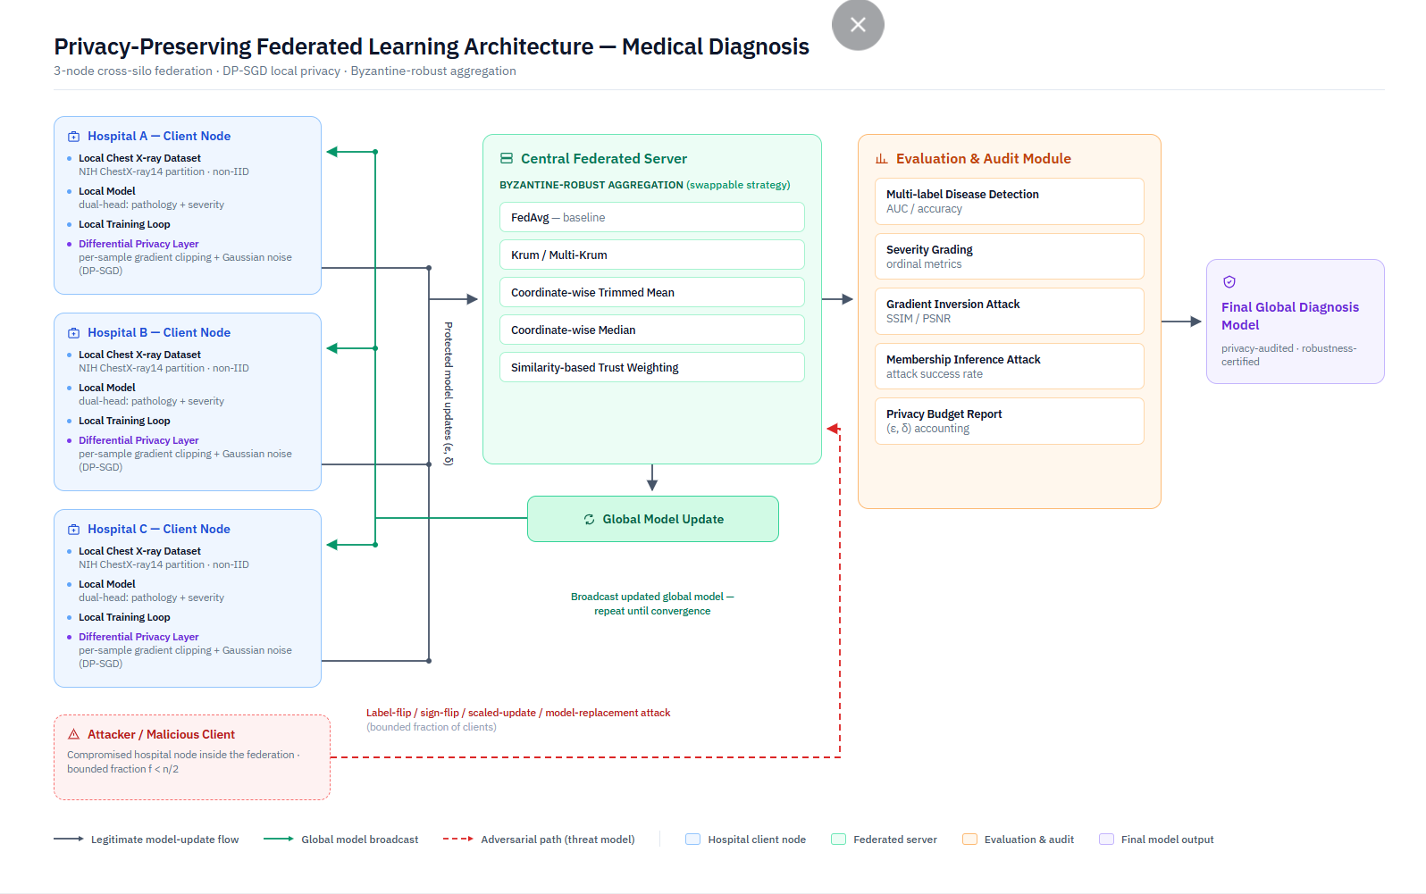
System Architecture — Privacy-Preserving Federated Learning Framework

Slide 11
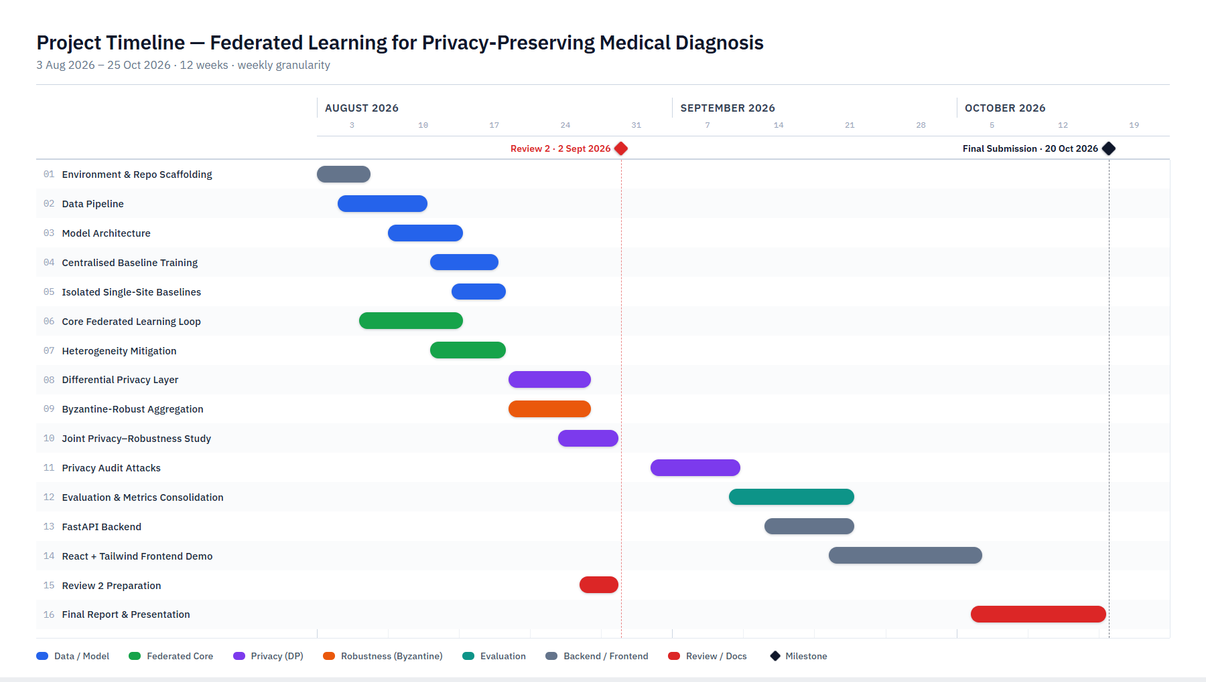
Project Timeline (Gantt Chart)

Slide 12
Functional Requirements
The system is expected to satisfy the following functional requirements:
FR1 — Local training without data movement. The system shall train the diagnostic model locally on each hospital node's own chest radiograph partition, without transmitting raw patient images or labels off-site at any point.
FR2 — Client-level differential privacy. Before transmission, the system shall apply per-sample gradient clipping and calibrated Gaussian noise to each client's model update (DP-SGD), so that no single training example can be reliably reconstructed or confirmed as part of a client's training set.
FR3 — Pluggable aggregation strategies. The central server shall support multiple aggregation rules — FedAvg, Krum, Multi-Krum, coordinate-wise trimmed mean, coordinate-wise median, and similarity-based trust weighting — selectable through configuration, without requiring changes to client-side code.
FR4 — Adversarial client simulation. The system shall be able to designate a configurable fraction of clients as adversarial and simulate label-flipping, sign-flipping, scaled-update, and model-replacement attack behaviours, to evaluate aggregation-rule resilience under threat.
FR5 — Formal privacy accounting. The system shall track and report the cumulative differential privacy budget (ε, δ) for every training run using a Rényi-DP accountant, rather than asserting privacy without measurement.
FR6 — Dual-head evaluation. The evaluation module shall report both multi-label pathology-detection performance and per-disease ordinal severity-grading performance for the global model after each round of aggregation.
FR7 — Privacy audit. The system shall be able to execute gradient-inversion and membership-inference attacks against intercepted client updates and report the resulting reconstruction quality and attack success rate at a given privacy budget.
FR8 — Demonstration interface. The system shall expose a FastAPI backend and a React + Tailwind CSS dashboard that visualises per-node training status, the flow of weight updates from leaf nodes to the centre node, and the aggregation event, for live demonstration purposes.

Slide 13
Modules
The system is organised into the following modules:
Data Pipeline Module. Handles loading of the NIH ChestX-ray14 dataset, derivation of the severity-proxy labels from the bounding-box subset, and construction of both IID and non-IID (label-skew) partitions across the three simulated hospital nodes. (Completed)
Model Architecture Module. Implements the shared backbone network with two prediction heads — multi-label pathology detection and ordinal severity grading. (Completed)
Federated Core Module. Implements the Flower-based client and server logic, including the FedAvg baseline strategy and the three-node simulation loop. (Completed)
Heterogeneity Mitigation Module. Adds FedProx-style proximal regularisation and FedBN-style local batch normalisation to the client training loop to handle non-IID data across nodes. (Completed)
Differential Privacy Module. Implements per-sample gradient clipping and calibrated Gaussian noise injection at the client, together with a Rényi-DP accountant that tracks the cumulative privacy budget across training rounds. (Completed)
Byzantine-Robust Aggregation Module. Implements Krum, Multi-Krum, coordinate-wise trimmed mean, coordinate-wise median, and similarity-based trust weighting as pluggable server-side strategies, along with the four attack-client behaviours used to stress-test them. (Completed)
Privacy–Robustness Composition Study Module. Provides the sweep framework that jointly varies privacy budget, attacker fraction, and heterogeneity level to characterise how the two defence layers interact — the project's central research contribution. (In Progress)
Privacy Audit Module. Will implement the gradient-inversion and membership-inference attacks used to empirically verify the system's privacy claims. (Planned)
Evaluation & Reporting Module. Will consolidate results across all experiment types into the metrics used for the final analysis. (Planned)
Demonstration Module (FastAPI + React/Tailwind). Will provide the backend and dashboard used to visually demonstrate the federated process live. (Planned)

Slide 14
Experiments and Results
At this stage of development, the centralised (upper-bound) and isolated single-site baseline training pipelines have been implemented and are runnable on the NIH ChestX-ray14 partitions. The core federated learning loop, built on Flower, has been implemented and verified end-to-end across three simulated hospital nodes under both IID and non-IID partitioning, with FedProx-style regularisation and FedBN-style local batch normalisation integrated to handle heterogeneity between nodes.
The client-level differential privacy layer is integrated into the local training loop, applying per-sample gradient clipping and calibrated Gaussian noise, with a Rényi-DP accountant tracking the cumulative privacy budget across training rounds. All five planned Byzantine-robust aggregation strategies — Krum, Multi-Krum, coordinate-wise trimmed mean, coordinate-wise median, and similarity-based trust weighting — have been implemented as interchangeable server-side strategies, alongside the four adversarial client behaviours (label-flipping, sign-flipping, scaled-update, and model-replacement) used to evaluate them.
The joint privacy–robustness composition sweep, which constitutes the project's core research experiment, has been set up as a configuration-driven framework, and initial pilot runs are currently underway. Full quantitative results — covering pathology-detection and severity-grading performance, attack success rates under varying adversarial fractions, and reconstruction quality (SSIM/PSNR) at different privacy budgets — are being generated through this framework and will be reported in full at the final submission, once the complete sweep across privacy budgets, attacker fractions, and heterogeneity levels has been executed.

Slide 15
Conclusion
Since Review 1, the project has moved from architectural design to a working implementation. The hierarchical federated architecture, the client-level differential privacy layer, and the complete set of Byzantine-robust aggregation strategies proposed in Review 1 have been implemented and integrated into a single, configurable training pipeline built on Flower. Heterogeneity mitigation through FedProx-style regularisation and FedBN-style local batch normalisation is in place, and — most importantly for the project's central research question — the experimental framework needed to characterise how differential privacy noise and robust aggregation interact under composition has been built and is now being exercised through pilot runs.
Development remains on track against the planned timeline. The remaining work consists of executing the full experimental sweep across privacy budgets, adversarial client fractions, and heterogeneity levels; running the gradient-inversion and membership-inference privacy-audit attacks; and completing the FastAPI backend and React/Tailwind demonstration dashboard. The detailed quantitative findings from the privacy–robustness–utility trade-off study will be presented at the final review, once these remaining experiments are complete.

Slide 16
References (1/2)
[1] M. Zulqarnain, S. J. Hussain, M. Z. Aslam, A. Fiaz, and M. Islam, “Federated learning for thoracic disease classification using convolutional neural networks and differential privacy,” Healthcare Technology Letters, vol. 13, no. 1, art. e70080, Jan. 2026.
[2] M. Karami, F. Ghassemi, H. Kebriaei, and H. Azadegan, “OptiGradTrust: Byzantine-robust federated learning with multi-feature gradient analysis and reinforcement learning-based trust weighting,” arXiv preprint arXiv:2507.23638, Jul. 2025.
[3] M. R. Islam, M. Z. Hossain, M. Ahmed, and M. S. S. Samu, “Privacy-preserving chest X-ray report generation via multimodal federated learning with ViT and GPT-2,” arXiv preprint arXiv:2505.21715, May 2025.
[4] S. M. Bokhari, S. Sohaib, and M. Shafi, “Fusion of personalized federated learning (PFL) with differential privacy (DP) learning for diagnosis of arrhythmia disease,” PLOS ONE, vol. 20, no. 7, art. e0327108, Jul. 2025.
[5] R. Ahmed, P. K. R. Maddikunta, T. R. Gadekallu, N. K. Alshammari, and F. A. Hendaoui, “Efficient differential privacy enabled federated learning model for detecting COVID-19 disease using chest X-ray images,” Frontiers in Medicine, vol. 11, art. 1409314, Jun. 2024.
Notes:
These are our ten references in IEEE format, across two slides.
Reference one is the base paper. Two through five are the supporting literature I covered on the first review slide.
I won't read these out — they're here for the record and for the report.

Slide 17
References (2/2)
[6] S. Pati, U. Baid, B. Edwards, et al., “Federated learning enables big data for rare cancer boundary detection,” Nature Communications, vol. 13, no. 1, art. 7346, Dec. 2022.
[7] J. Ziegler, B. Pfitzner, H. Schulz, A. Saalbach, and B. Arnrich, “Defending against reconstruction attacks through differentially private federated learning for classification of heterogeneous chest X-ray data,” Sensors, vol. 22, no. 14, art. 5195, Jul. 2022.
[8] M. Adnan, S. Kalra, J. C. Cresswell, G. W. Taylor, and H. R. Tizhoosh, “Federated learning and differential privacy for medical image analysis,” Scientific Reports, vol. 12, no. 1, art. 1953, Feb. 2022.
[9] G. Kaissis, A. Ziller, J. Passerat-Palmbach, et al., “End-to-end privacy preserving deep learning on multi-institutional medical imaging,” Nature Machine Intelligence, vol. 3, no. 6, pp. 473–484, Jun. 2021.
[10] I. Dayan, H. R. Roth, A. Zhong, et al., “Federated learning for predicting clinical outcomes in patients with COVID-19,” Nature Medicine, vol. 27, no. 10, pp. 1735–1743, Oct. 2021.
Notes:
References six through ten — the Nature Communications rare-cancer federation, the Sensors reconstruction-attack study, the Scientific Reports topology study, PriMIA, and EXAM.
To close: the literature shows federated learning works clinically, and separately shows that privacy and robustness defences each work in isolation. What it does not show is what happens when you run them together, on a clinically meaningful task, with the privacy claim actually tested. That composition is what this project measures.
That completes Review-1. Thank you — we're happy to take questions.

